Slide 1
Functional Communication
Created by Shantal S. Wright, OTS
Jacksonville University

Slide 2
Joint Attention
Joint attention involves sharing a common focus on something (such as other people, objects, a concept, or an event) with someone else.
It is a behavior in which two people focus on an object or event, for the purpose of interacting with each other
It is a form of early social and communicative behavior

Slide 3
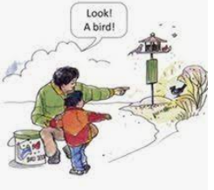
Joint Attention and Autism
Children with autism may have difficulties with joint attention, as they may find it difficult to interact while paying attention to an object and a person.
This could result in missed opportunities to interact and communicate with others. Also, it may make it difficult for a person with autism to get their wants and needs met.

Slide 4
Ways to encourage joint attention
Focus on faces and developing eye contact – encourage your child to look at you. It is considered socially appropriate to look at someone who is talking to you and faces provide a lot of social cues. Making eye contact can be especially difficult for children with autism, so discuss with your therapist whether this is an appropriate goal.
Play and practise turn-taking – this helps to develop joint attention in a natural, relaxed setting. Start with short sessions and gradually increase the time.
Complete something together, such as a puzzle or craft activity like weaving.
Encourage your child to shift their attention from what they are playing with to what you have.
Use an animated tone of voice, gestures and facial expressions to help establish joint attention.
Use items that your child most enjoys playing with to engage their interest.
Bubble blowing is a great activity for working on joint attention and communication skill development.
Practice joint attention as part of your daily routine, during tasks such as brushing teeth or at bath and mealtimes.

Slide 5
Notes:
Joint Attention – Why it’s important to teach your child to engage and enjoy the company of others - YouTube

Slide 6
Prompting
An effective strategy used to promote and enhance social interaction as well as language and communication skills
Prompting is where an adult or peer assists a learner to acquire a new skill
Physical (when a child needs full or partial physical assistance to complete the skill (e.g., an adult puts the child’s shoes on for them).
Verbal (e.g. providing an instruction “Get your shoes”, or a lower intensity verbal prompt may be “This says … [pause])”
Prompts can be gestural (e.g., gesturing cutting when wanting the child to cut something out, or pointing to the mat when wanting the child to come to the mat)
Visual (e.g., checklists, photos, schedules), provision of a model (e.g., when the verbal or visual prompt is not sufficient the adult may show the child exactly what to do - if it’s a motor skill) or tell the child the answer to allow for imitation (e.g., “It says baa”)

Slide 7
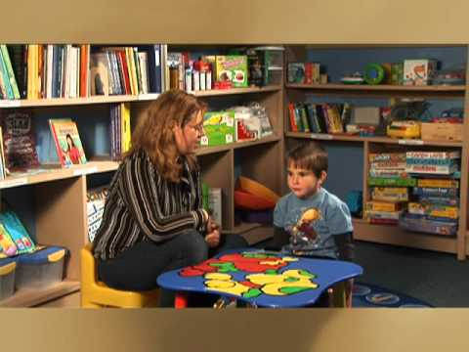
Please click on the link provided below to watch the video
http://hcut.to/v/xs3ZkHu
Notes:
ABA Autism Training - Chapter 3 - Prompting - YouTube

Slide 8
Please click on the link provided below to watch the video.
http://hcut.to/v/xpWfLR4

Slide 9
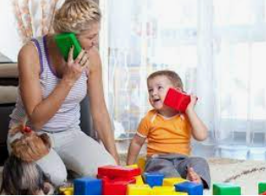
Imitating
Serves two distinct functions:
A learning function, through which infants acquire new skills and knowledge
A social function, through which infants engage in social and emotional exchanges with others
Imitation is essential for developing play skills, peer interactions during play participation and for learning new skills for performing functional tasks.

Slide 10
Notes:
Imitation – Tips for teaching your child how to copy and learn from others - YouTube

Slide 11
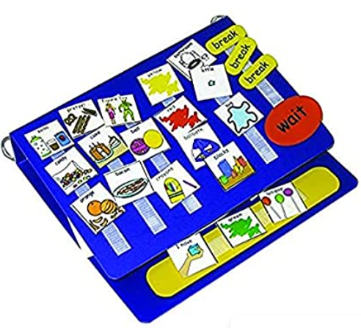
Picture Exchange Communication System (PECS)
A system used to assist children with communication who are unable to do so through speech. It is one method that a child who is non-verbal can use to indicate their needs and wants.

Slide 12
Notes:
PECS Phase 1 - YouTube

Slide 13
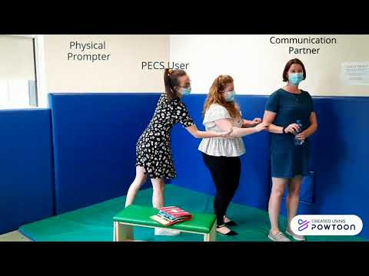
Please click on the link provided below to watch the video.
PECS Phase 2 - YouTube
Notes:
PECS Phase 2 - YouTube

Slide 14
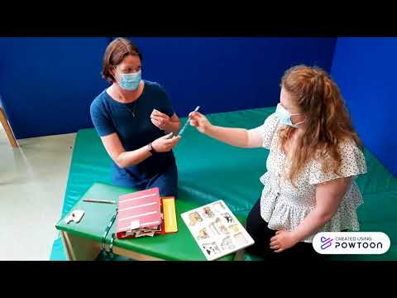
Please click on the link provided below to watch the video.
PECS Phase 3 - YouTube
Notes:
PECS Phase 3 - YouTube

Slide 15
Simple Commands
Teaching children with Autism to follow simple directions is an important skill for them to learn. The ability to follow simple directions allows opportunities for your child to gain independence, regulation skills, communication skills, productivity in daily routine tasks, and practice gross motor and fine motor skills. Having these skills are important in school environments, home, and other natural settings. Children can gain the ability to follow simple directions to:
“Wave!”
“Walk here.”
“Turn off the light and get into bed.”
These skills improve the daily life of children and make your life much easier as well.
Teaching children with Autism to follow simple directions is progressive and may require greater reinforcement in the beginning. There are many ways to make following directions into a fun, rewarding activity! In teaching children, consistency is important.
Notes:
Give me/put in

Slide 16
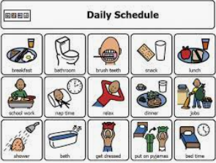
Picture Schedule
A graphic representation of scheduled tasks and activities.
Useful for breaking down tasks that have multiple steps and ensuring that children follow rules and deadlines.
Can reduce anxiety by providing consistency while also reducing resistance that comes with certain activities.
Although most people associate visual schedules with pictures or photographs, events can be triggered through toys, objects and even word phrases. The visual schedule itself is a constant reminder to children where they should be, what they should be doing and when she should start and finish.
Notes:
Brief introduction

Slide 17
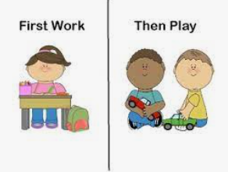
Reinforcement (Reward) System
The principle of a reinforcement or reward is to provide an opportunity for a child to engage in more probable behaviors (or activities) that will reinforce less probable behaviors (or activities). For example, if a child enjoys playing with her tablet (more probable) and avoids eating a serving of fruits on a plate (less probable), we might allow her to play with the tablet after (contingent upon) eating 3 grapes. We often refer to this technique as ‘Do this…get that’.
Notes:
Do this get that (primack principle)

Slide 18
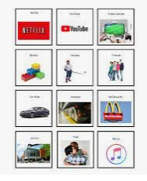
Choice boards
A choice board is a visual representation of items/activities that are available for an individual to choose from. This tool is used to encourage communication, provide a visual reminder of what activities are available, and to encourage independent decision making throughout the day. The use of choice boards may increase your child’s motivation by providing them options for preferred activities or for which activity comes next. Offering a choice before an activity/task begins may increase participation and decrease the possibility of your child engaging in challenging behaviors.
Preferred items (tablet, toys, sensory bins)
Food items (cookie, crackers, candy)
Activities (arts and crafts, coloring, books, lego)
Outings (Devon House, toy store, fast food restaurant)
Notes:
I want

