Slide 1
Teaching Language at Home

Slide 2
Building Language through play
https://youtu.be/5n9vlBtbji8

Slide 3
Advanced Organizer
Verbal Behavior
Manding or Requesting
Tacting or Labeling
Echoics or Repeating
Intraverbals or Answering Questions
Transfer procedures
Building Language through Play

Slide 4
VERBAL BEHAVIOR
CHEAT SHEET
VERBAL BEHAVIOR LABEL
EXPLANATION
“Requesting”
For items, activities or information”
Mand
Tact
“Labeling”
Labeling items or activities in the environment
Echoic
“Repeating”
Saying exactly what you just heard
Intraverbal
“Answering Questions”
Talking about things or activities
without their presence

Slide 5
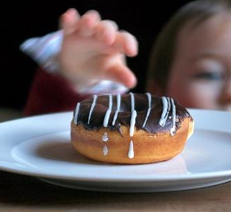
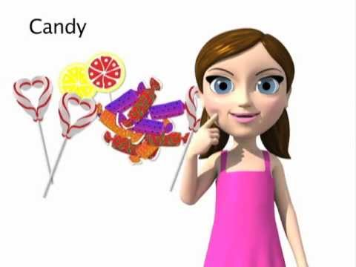
Manding
Mands are requests for something (e.g., activity, item, etc.) and usually occur as a result of deprivation
Mands are typically one of the very first skills taught
Motivation is strong
Can result in a significant reduction in problem behavior
Examples
“Want juice”
ASL sign for “candy”

Slide 6
Manding
https://youtu.be/d27kRgIvvTs

Slide 7
Tips for Success
Make sure you have something your child really wants and will work for
Depending on your child’s language (i.e., if they aren’t vocalizing words yet), you might first work on pointing to what they want
Make sure it’s visible and enticing
Start small in terms of expectations and work your way up!
Avoid saying “What do you want?”
Instead say the object name “Cookie”
Avoid saying “Good job!”
Instead say the object name again e.g., “Cookie”

Slide 8
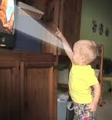
Tacting
Tacts are essentially the individual labeling things in his environment
Can be labeling…
Items and activities
Actions
Events
Feelings
Can be expressive (labeling things seen) or receptive (correctly identifying a label when asked)
Examples
Selecting “dog” from an array of pets
Pointing to iPad and saying “iPad”

Slide 9
Tacting
https://youtu.be/1Y_SFcxWAKU

Slide 10
Tips for Success
Start with objects or activities your child really enjoys
Get on the ground, play with your child and label objects as they are picked up by your child
Start with play and work your way up to labeling objects at a teacher like a teacher.
Your child may first need to work on being able to sit for short periods to work
You can do this by requiring sitting for several seconds or minutes depending on their ability and reinforcing this with a preferred toy or a few bites of a favorite snack

Slide 11
Echoic
Involves the repeating, or echoing, of verbal information provided
Considered important for speech development and is often a skill taught very early in verbal behavior instruction
Example: The teacher says presents a picture of “Tiger” and says “Tiger” with an anticipatory look. The child responds “Tiger.”

Slide 12
Intraverbal
This verbal operant involves explaining, describing, or talking about something that is not currently present
Can be answering questions or filling in “blanks”
Examples
The teacher sings “Old MacDonald had a farm…” and waits with an anticipatory look for the children to complete “E-I-E-I-O.”
The teacher says “The cow says…” and waits with an anticipatory look for the child to say “Moo.”

Slide 13
Intraverbals
https://vimeo.com/115143289

Slide 14
Transfer Procedures
Notes:
Start at 1:35

Slide 15
Building language Through Play

Slide 16
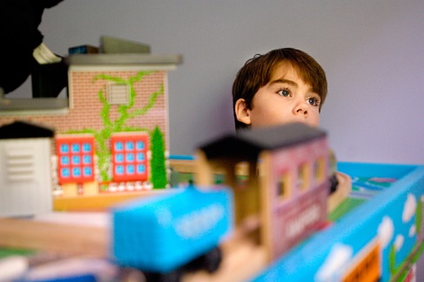
Different Kinds of Play with Different Purposes
Child-directed Play
Purpose: To build relationship with the child, to praise and reinforce skills you want to see continue
Parent-directed Play
Purpose: To develop skills in the child (e.g., waiting, language building, sharing, turn-taking, etc.)
With any language-building program, it’s best to alternate between the two
The length of time for each will depend on
the child’s tolerance and stamina

Slide 17
Parent-Directed Play: Picking Activities
It’s important to pick activities that…
Are engaging and maintain attention
Are highly reinforcing
They will be motivated to talk!
Consider: Is this activity so preferrable that it might be disruptive?
Start with something less reinforcing

Slide 18
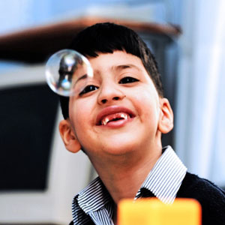
Bubbles
Therapist: (Place bubble jar in front of child, trying to get him to request that you open it) Open Bubbles!
Child: Open!
Therapist: Let’s blow bubbles! (Pucker lips)
Child: (Watches mommy and bubbles, smiles)
Therapist: (Blows bubbles) Hooray!!! (Prompt child to ask for more if they don’t initiate)
Child: More bubbles!!!

Slide 19
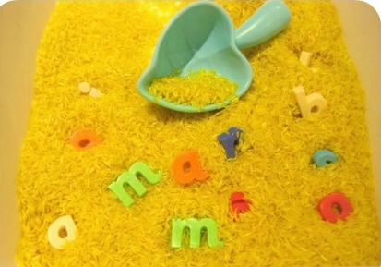
Rice Tub
Mommy: (With enthusiasm) Let’s hide the animals!!! (Can be adjusted up to letters, numbers, or words)
Child: (Looks at you and the rice tub. Takes an animal from Mommy’s hand. Pushes it into the rice. Do this for 2 or 3 animals.)
Mommy: Where’s the cow??? Moo!! (Sift through the rice looking for the cow.)
Child: (Sifts through the rice too, looking for cow. If he is just sifting, act as if he is looking for the cow.)
Mommy: When the cow is near his hand say, You found the cow!! Hooray!! Moo!!

Slide 20
Puzzle
Mommy: Let’s do a puzzle!!! (Give a choice of 2 puzzles that are of interest to your child.)
Child: (Looks at Mommy and chooses the puzzle he or she wants to complete.)
Mommy: Take out all the pieces and do one of the following:
Take turns putting in pieces (Mommy and child can label pieces as they are placed in puzzle.)
Give your child a hint to help them pick a specific piece (i.e., “Which one is the one that says, ‘Neigh’?”)
Hide a necessary piece and have them ask you where it is.
Hide a piece (within view) in the room and search (in a dramatic way) together for it.
Mommy: (When puzzle is complete…) We did it!!! (Raise your hands as it to say, “Hooray!” In subsequent routines, raise you hands without saying anything and see if your child will say, “We did it!” or “Hooray!”)

Slide 21
Story Time
Mommy: Help me read this book!! (Give your child a picture to Velcro onto book)
Child: (Looks at Mommy, smiles, looks at book in anticipation.)
Mommy: What is it? or Point to ___ or Let’s count 1, 2…(Spread out pictures on floor, reads with expression, prompts child to attach corresponding picture to the book, make corresponding sounds,...)
Child: (Participates, looks at Mommy at specific parts of book, comments on pictures, or story events.)

Slide 22
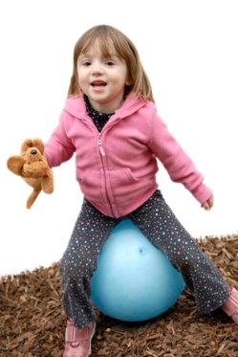
Therapy Ball, Trampoline, or Bath Time
Mommy: Bounce, bounce, bounce!! (or Splash, Splash, Splash) Who wants to bounce? (If child is close by and is comfortable with getting onto ball, place child on ball and proceed to bounce him on top, while holding his wait or underarms.)
Child: (Giggles, looks at mommy, vocalizes.)
Mommy: Let’s go on a ride. 1, 2, 3!! (Bounce child.)
Child: 1, 2, 3!! (Smiles, watches Mommy)
Mommy: All done!! (Wait to see if child wants more. Prompt if necessary “What do you want?”)
Child: More bounce!! OR More ball!!

Slide 23
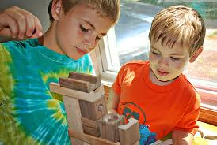
Stacking Cups or Blocks
Mommy: I’m building a big tower.
Child: (Watches mommy and cups, smiles.)
Mommy: 1, 2, 3… (Count as you stack each cup; Alternatively, label colors.)
Child: (Watches or participates.)
Mommy: I’m going to huff and puff and blow our tower down!!! 1, 2… (Look expectantly; Wait for child to say 3; Huff and puff in an exaggerated manner. Blow and knock cups down with your hands, making a lot of noise.) BOOM!
Child: (Watches, helps, giggles, attempts to repeat routine.)
Mommy: Let’s do it again. Help me huff and puff!!!

Slide 24
Questions?
Angela Mann, Ph.D., BCBA
Angela.mann@unf.edu

